Slide 1

WASTE SORTER
Submitted in the partial fulfillment for the award of the degree of
BACHELOR OF ENGINEERING
IN
Artificial Intelligence and Machine Learning
Submitted by:
Aakash Kumar: 18BCS6007
Anirudh Tyagi: 18BCS6040
Mrigakshi: 18BCS6006
Shubham Mishra: 18BCS6073
Pratibha: 18BCS6093
Under the Supervision of:
Somsirsa Chatterjee
Department of AIT-CSE
DISCOVER . LEARN . EMPOWER

Slide 2
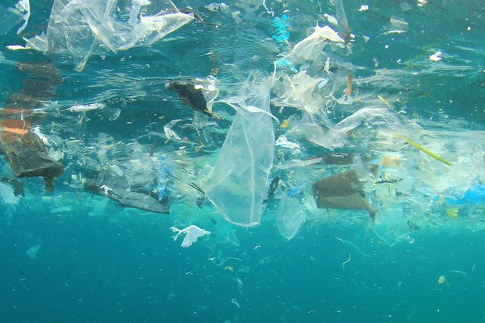
WASTE
SORTER

Slide 3
Outline
Introduction to Project
Problem Formulation
Objectives of the work
Methodology used
Results and Outputs
Conclusion
Future Scope
References

Slide 4

Introduction to Project
PROBLEM DEFINITION
01
Pollution is one of the serious threats in our society. There are three major types of pollution, air pollution, water pollution and land pollution. The rising level of pollution around the globe is becoming one of a major concern of common people, political parties and environmentalists.
A lot of efforts have been made to reduce the air and water pollution levels and various initiatives like Clean India are put forward to reduce land pollution in India. Presently around 5.25 trillion litter objects are present in the oceans, this quantity is steadily increasing with every pass of day.
Detection of waste in the water is not a new issue and researchers of different domains like civil engineers, biomedical, etc. have contributed to different aspects of this issue. Presently when most our daily world problems are tried to be solved with help of AI why not try to find a solution to this problem as well.

Slide 5
Introduction to Project
Project Overview
Specifications
02
03
Hardware Specifications
1. Smartphone /Laptop (After deployment)
2. NVIDIA GPU 1050,1650,1050Ti.
Software Specifications
1. Python for programming
2. Jupyter Notebook
3. Anaconda
4. Google Colab
5. Android Studio (**optional)
In this project we have applied a deep learning based object detection model. This proposed model detects and classifies the different pollutants and harmful waste in water bodies as well as on land.
In this project, we will train a Convolutional neural network to classify images into different types of waste materials which help us further in achieving the above goal.

Slide 6

Problem Formulation
The project- Waste Sorter is an initiative to solve some of the existing problems related to waste and pollution caused by it. It would also help some of the ongoing movements like clean India.
The problems it would solve are:
Most of the plastic waste is disposed of near or in water bodies due to which aquatic life is facing serious threats. This project will help in solving this problem by detecting the water in water and further classifying it so that it can be removed easily.
Poor waste management is the most dangerous problem specially in India. It causes a lot of other problems and diseases. Using this project, we can manage the waste more accurately.

Slide 7
Problem Formulation(Cont.)
3. Plastic pollution is the major problem these days. Plastic has also been banned in several areas but still managing the plastic waste is still a challenging task. This project will not only help us to manage plastic waste under water but in other areas too. It will classify different types of waste.
From the literature review, it is observed that studies highlight the need for an efficient and scalable approach for detecting waste. The existing techniques are not that efficient and accurate. So there is a need to develop more accurate waste detecting systems that can sort all types of waste in the image. There is also a need to deploy the waste sorter which has not been done yet but in this project will also try to build an android app related to.

Slide 8

Objectives
The proposed research is aimed to carry out work leading to the development of an approach for automatic waste detection in water bodies. The proposed aim will be achieved by dividing the work into following objectives:
Image classification. It will be done to classify different types of waste and other things in an image so that one can easily sort the waste.
Object Detection. The project will use object detection using neural networks to detect various types of waste in the pictures.
Since neural networks play an important role in image classification and detection. Therefore, it is also one of the main objectives.
At last, we will also try to build an android app which would be an optional objective.

Slide 9
METHODOLOGY
The following methodology will be followed to achieve the objectives defined for proposed research work:
Detailed study of previous similar projects and research papers was done as mentioned in the synopsis.
We used the ResNet 34 pre trained neural network and on model Image Network.
The model consists of 34 layers.

Slide 10
METHODOLOGY (CONT.)
The dataset that we are using in our model is TrashNet. TACO and Aqua Trash will also be included.
We have used transfer learning i.e. the weights were freezed and only output and input images were changed.

Slide 11
METHODOLOGY (CONT.)
CPU & GPU time computation was compared. GPU is found out to be faster on image processing.
Our output comes in five different classes.
The model can be deployed either on web or on Android apps using tensorflow lite(optional).

Slide 12
RESULTS
The project classifies the above dataset of images containing waste images into six categories irrespective of land or water (paper, plastic, trash, cardboard, metal and glass). We were able to achieve 91.8% accuracy using the Res Net 34 model using transfer learning.

Slide 13
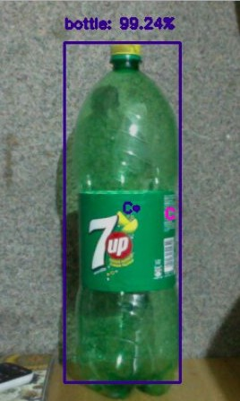

OUTPUT 1

Slide 14
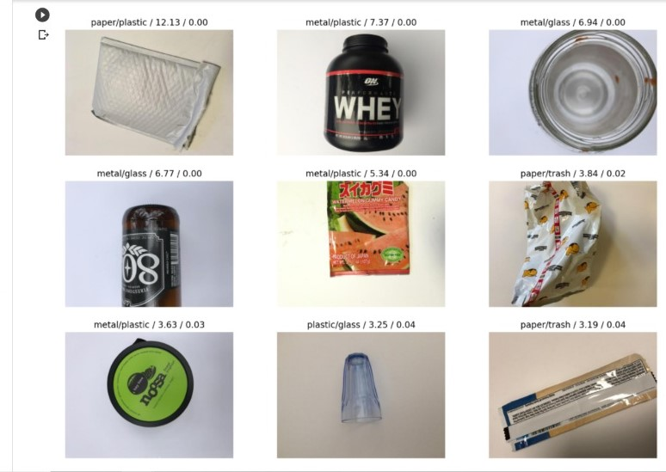
OUTPUT 2

Slide 15
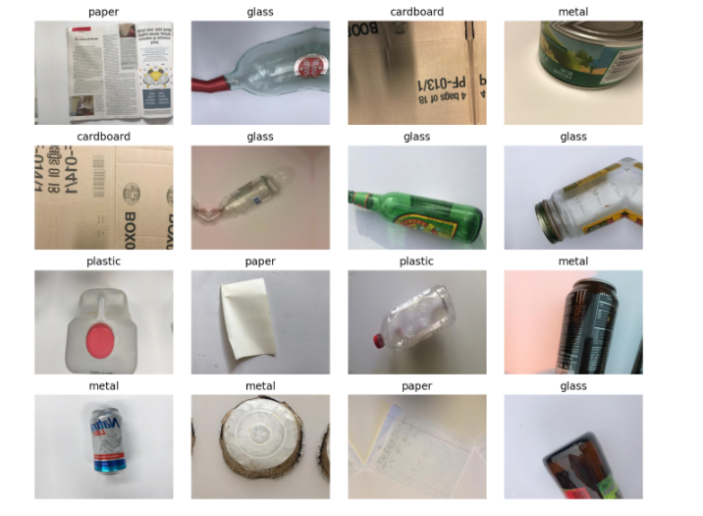
OUTPUT 3

Slide 16
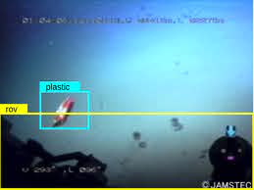
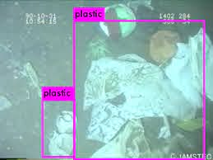
OUTPUT 4 (TO Do after deployment)

Slide 17
CONCLUSION
When it comes to waste management in India, nothing is quite right. The Central Pollution Control Board in its report which was released in 2009 indicates that around 62 million tons of solid waste is produced in our country every year, of which less than 20% or only 12 million tons are treated. This essentially means that the remaining 52 million tons of waste remain ‘untreated’ and contaminate land or make its way into rivers, lakes and wetlands. India is gradually becoming a water scarce country as water resources like ponds, lakes and rivers are on a decline. Despite environmental regulations that protect the quality of streams, lakes, and wetlands, solid waste in the form of trash, litter, and garbage often ends up in these surface waters.
This project intends to provide help in keeping our Land as well as our Water bodies clean from pollution. By the use of various machine learning models, this project is trained on a dataset of images to detect waste present on land and water bodies. It helps in sorting out the types of wastes into biodegradable and non biodegradable.

Slide 18
Future Scope
Can be combined with android and web development to make the project a real-time working model.
The model can be trained to classify waste from videos dataset too instead of only from images.
Can be used to clean water bodies, beaches, and public places in future.
The model will also be useful for recycling the plastic and other non-biodegradable waste.

Slide 19
HOW TO DEPLOY IT?
CCTVs
On road detection of waste is possible through CCTVs
Smartphones
Waste sorter can be deployed to camera phones which make use of the inbuilt camera to detect and classify waste.
GoPro
Waste sorter can be deployed to GoPros for easy underwater surveillance.

Slide 20
References:
[1] AquaVision: Automating the detection of waste in water bodies using deep transfer learning
https://www.sciencedirect.com/science/article/pii/S2666016420300244
[2] How to build an image classifier for waste sorting
https://towardsdatascience.com/how-to-build-an-image-classifier-for-waste-sorting-6d11d3c9c478
[3] L. Parker
Ocean trash: 5.25 trillion pieces and counting, but big questions remain
National Geographic, 11 (2015)
Google Scholar

Slide 21
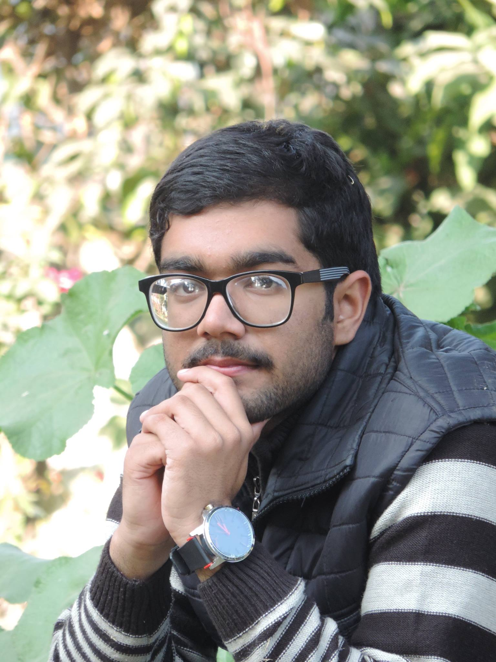



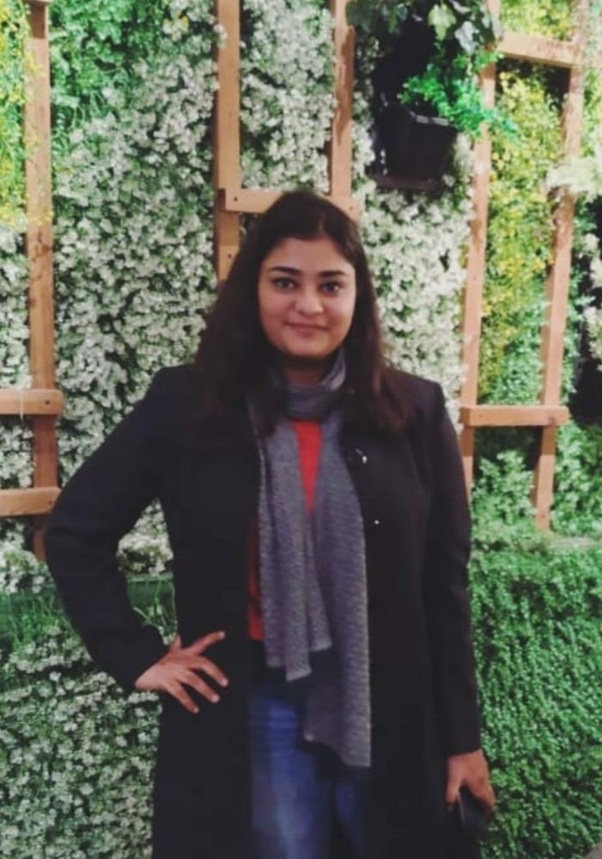
MEET THE TEAM
Aakash Kumar
Anirudh Tyagi
Mrigakshi
UID : 18BCS6007
UID : 18BCS6040
UID : 18BCS6006
Pratibha
Shubham Mishra
UID : 18BCS6093
UID : 18BCS6073
Branch: Artificial Intelligence and Machine Learning
Semester: 5th
Department: AIT

Slide 22
THANKS!

